Slide 1





Asynchronous Programming and Promises
Promises. Async / Await. Web Workers
Promises
Promises
SoftUni Team
.then()
Technical Trainers
.catch()
Software University
http://softuni.bg

Slide 2



Table of Contents
Asynchronous Programming
Promises in JS – Concepts
Promises with AJAX
Using Async / Await
Web Workers

Slide 3
Have a Question?
sli.do #promises

Slide 4
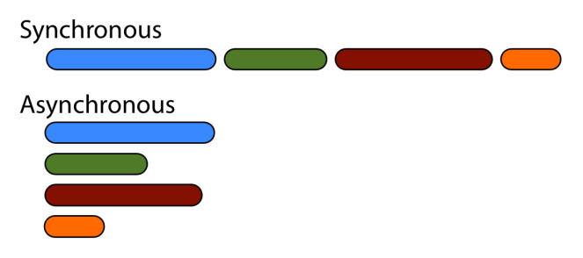
Asynchronous Programming

Slide 5
Asynchronous Programming in JS
Asynchronous programming deals with the needs to run several tasks (pieces of code) in parallel, in the same time
In JS the asynchronous programming is based on callbacks
You run a background task and pass a callback function

Slide 6
Asynchronous Programming – Example
setTimeout(task1, 1000);
setTimeout(task2, 1500);
setTimeout(task3, 500);
console.log("All tasks started");
function task1() { console.log("task1 finished") }
function task2() { console.log("task2 finished") }
function task3() { console.log("task3 finished") }
3 tasks run in parallel and
will finish at different time
All tasks started
task3 finished
task1 finished
task2 finished
All tasks run in parallel

Slide 7
Promises in JS
Promises
.then()
.catch()
Objects Holding Asynchronous Operations

Slide 8
What is a Promise?
A promise is an object holding an asynchronous operation
A result which may be available now, or in the future, or never
Promises may be in one of these states:
Pending – operation still running (unfinished)
Fulfilled – operation finished (and the result is available)
Failed – operation is failed (and an error is available)
Promises in JS use the Promise object

Slide 9
JS Promises – Syntax
let p = new Promise(function(resolve, reject) {
// Do an async task and then resolve or reject
if (/* operation successful */)
resolve('Success!');
else /* operation failed */
reject('Failure!');
});
p.then(function(result) {
/* process the result (when the promise is resolved) */ })
.catch(function(error) {
/* handle the error (when the promise is rejected) */ });

Slide 10
Promise.then() – Example
console.log('Before promise');
new Promise(function(resolve, reject) {
setTimeout(function() {
resolve('done');
}, 500);
})
.then(function(result) {
console.log('Then returned: ' + result);
});
console.log('After promise');
Before promise
After promise
Then returned: done
Resolved after 500 ms
Check your solution here: https://judge.softuni.bg/Contests/360

Slide 11
Promise.catch() – Example
console.log('Before promise');
new Promise(function(resolve, reject) {
setTimeout(function() {
reject('fail');
}, 500);
})
.then(function(result) { console.log(result); })
.catch(function(error) { console.log(error); });
console.log('After promise');
Before promise
After promise
fail
Rejected after 500 ms
Check your solution here: https://judge.softuni.bg/Contests/360

Slide 12
JS Promises – Example – First Task
let p1 = new Promise(
function(resolve, reject) {
console.log("task1 started.");
setTimeout(function() {
resolve("task1 result");
console.log("task1 finished.");
}, 1000);
}
);

Slide 13
JS Promises – Example – Second Task
let p2 = new Promise(
function(resolve, reject) {
console.log("task2 started.");
setTimeout(function() {
resolve("task2 result");
console.log("task2 finished.");
}, 1500);
}
);

Slide 14
JS Promises – Example – Third Task
let p3 = new Promise(
function(resolve, reject) {
console.log("task3 started.");
// reject('cannot execute task3');
setTimeout(function() {
resolve("task3 result");
console.log("task3 finished.");
}, 500);
}
);

Slide 15
JS Promises – Example – Third Task
console.log("All tasks started.");
Promise.all([p1, p2, p3])
.then(function(result) {
console.log("All tasks finished.");
console.log("Result: " + result.join(", "));
// nonExistingFunction();
})
.catch(function(error) {
console.log("Some of the tasks failed.");
console.log("Error: " + error);
});
Error in then() block will reject the promise
Check your solution here: https://judge.softuni.bg/Contests/360

Slide 16

Promises with jQuery AJAX
Promises
.then()
.catch()

Slide 17
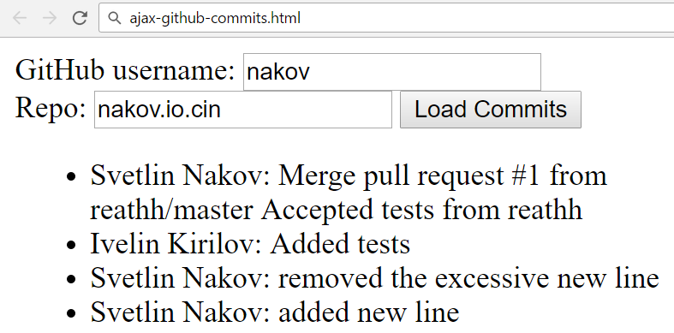
Problem: Load GitHub Commits with AJAX
GitHub username:
<input type="text" id="username" value="nakov" /> <br>
Repo: <input type="text" id="repo" value="nakov.io.cin" />
<button onclick="loadCommits()">Load Commits</button>
<ul id="commits"></ul>
<script>
function loadCommits() {
// AJAX call …
}
</script>

Slide 18
Solution: Load GitHub Commits with AJAX
function loadCommits() {
$("#commits").empty();
let url = "https://api.github.com/repos/" +
$("#username").val() + "/" +
$("#repo").val() + "/commits";
$.get(url)
.then(displayCommits)
.catch(displayError);
function displayCommits(commits) { … }
function displayError(err) { … }
}
jQuery AJAX methods return promises

Slide 19
Solution: Load GitHub Commits with AJAX (2)
function displayCommits(commits) {
for (let commit of commits)
$("#commits").append($("<li>").text(
commit.commit.author.name + ": " +
commit.commit.message
));
}
function displayError(err) {
$("#commits").append($("<li>").text("Error: " +
err.status + ' (' + err.statusText + ')'));
}
Check your solution here: https://judge.softuni.bg/Contests/360

Slide 20
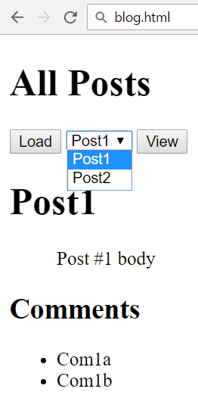
Problem: Blog (Posts with Comments)
Create a Kinvey app
Create user "peter" with password "p"
Create posts "Post1" and "Post2"
Create comments "Com1a" and "Com1b" for "Post1"
Create comments "Com2a", "Com2b" and "Com2c" for "Post2"
Write a JS app to display all posts and view selected post along with its comments

Slide 21
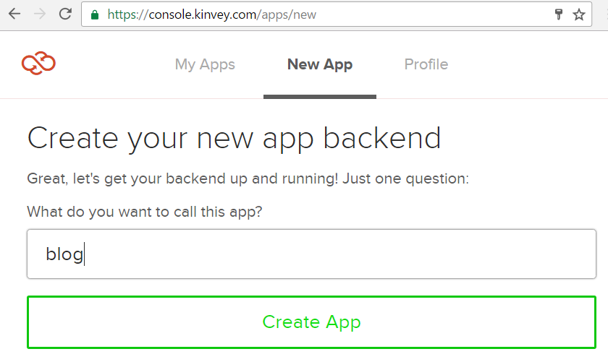
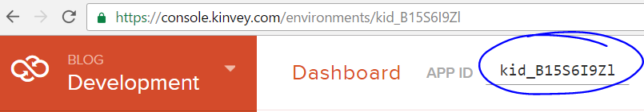
Solution: Blog – Create a Kinvey App
Remember your app ID

Slide 22
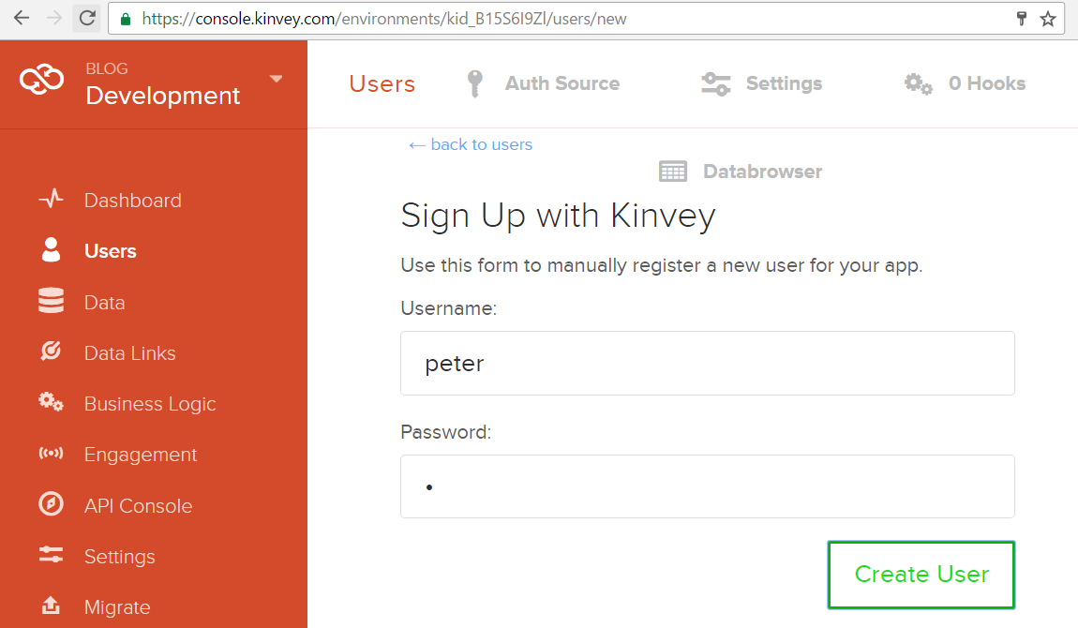
Solution: Blog – Create User "peter"

Slide 23
Solution: Blog – Create the First Post
Insert your Kinvey App ID here
POST /appdata/kid_B15S6I9Zl/posts/ HTTP/1.1
Host: baas.kinvey.com
Authorization: Basic Z3Vlc3Q6Z3Vlc3Q=
Content-Type: application/json
{ "title":"Post1", "body":"Post #1 body" }
Base64(user:pass)
{ "title": "Post1", "body": "Post #1 body", …,
"_id": "582cde77209db9d9730bab03" }
Remember the post _id

Slide 24
Solution: Blog – Create the Comments
POST /appdata/kid_B15S6I9Zl/comments/ HTTP/1.1
Host: baas.kinvey.com
Authorization: Basic Z3Vlc3Q6Z3Vlc3Q=
Content-Type: application/json
{ "text":"Com1a", "post_id":"582cde77209db9d9730bab03" }
Use post _id from the previous request
POST /appdata/kid_B15S6I9Zl/comments/ HTTP/1.1
Host: baas.kinvey.com
Authorization: Basic Z3Vlc3Q6Z3Vlc3Q=
Content-Type: application/json
{ "text":"Com2a", "post_id":"582cde77209db9d9730bab03" }

Slide 25
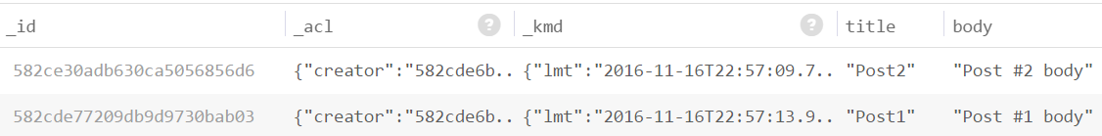
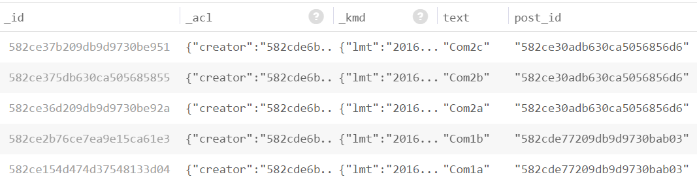
Solution: Blog – Create the Second Post
Create the second post "Post2" + its 3 comments
The "posts" and "comments" collections should look like these:

Slide 26
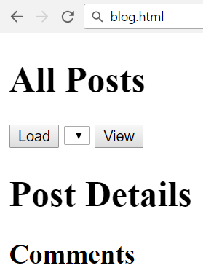
Solution: Blog – HTML Code
<script src="jquery-3.1.1.min.js"></script>
<script src="blog.js"></script>
<h1>All Posts</h1>
<button id="btnLoadPosts">Load</button>
<select id="posts"></select>
<button id="btnViewPost">View</button>
<h1 id="post-title">Post Details</h1>
<ul id="post-body"></ul>
<h2>Comments</h2>
<ul id="post-comments"></ul>

Slide 27
Solution: Blog – JS Code
$(document).ready(function() {
const kinveyAppId = "kid_B15S6I9Zl";
const serviceUrl = "https://baas.kinvey.com/appdata/" + kinveyAppId;
const kinveyUsername = "peter";
const kinveyPassword = "p";
const base64auth = btoa(kinveyUsername + ":" + kinveyPassword);
const authHeaders = { "Authorization": "Basic " + base64auth };
$("#btnLoadPosts").click(loadPostsClick);
$("#btnViewPost").click(viewPostClick);
function loadPostsClick() { … }
function viewPostClick() { … }
…
});

Slide 28
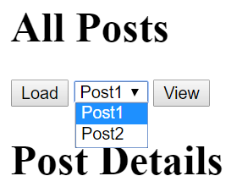
Solution: Blog – Load Posts
function loadPostsClick() {
let loadPostsRequest = {
url: serviceUrl + "/posts",
headers: authHeaders,
};
$.ajax(loadPostsRequest)
.then(displayPosts)
.catch(displayError);
}

Slide 29
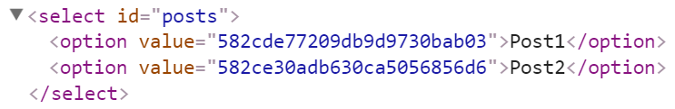
Solution: Blog – Display Posts as Options
function displayPosts(posts) {
$("#posts").empty();
for (let post of posts) {
let option = $("<option>")
.text(post.title)
.val(post._id);
$("#posts").append(option);
}
}

Slide 30
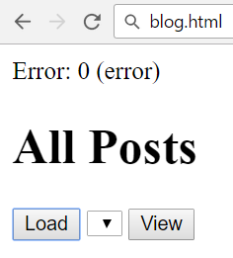
Solution: Blog – Handle AJAX Errors
function displayError(err) {
let errorDiv = $("<div>").text("Error: " +
err.status + ' (' + err.statusText + ')');
$(document.body).prepend(errorDiv);
setTimeout(function() {
$(errorDiv).fadeOut(function() {
$(errorDiv).remove();
});
}, 3000);
}

Slide 31
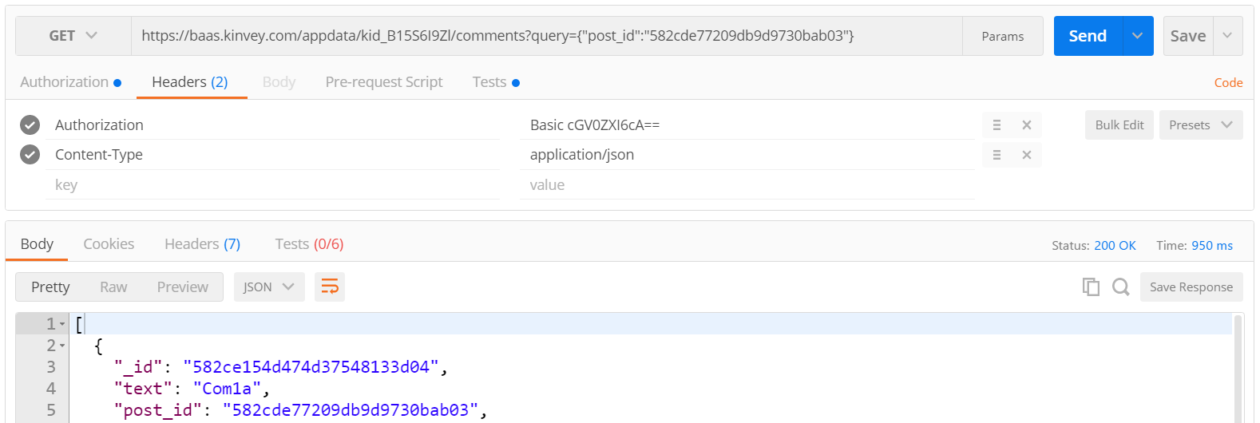
Solution: Blog – Load Post Comments Query
Kinvey allows querying collections:
https://baas.kinvey.com/appdata/kid_B15S6I9Zl/comments?query={"post_id":"582cde77209db9d9730bab03"}

Slide 32
Solution: Blog – [View Post] Button Click
function viewPostClick() {
let selectedPostId = $("#posts").val();
if (!selectedPostId) return;
let requestPosts = $.ajax({
url: serviceUrl + "/posts/" + selectedPostId,
headers: authHeaders });
let requestComments = $.ajax({ url: serviceUrl + `/comments/?query={"post_id":"${selectedPostId}"}`,
headers: authHeaders });
Promise.all([requestPosts, requestComments])
.then(displayPostWithComments)
.catch(displayError);
}

Slide 33
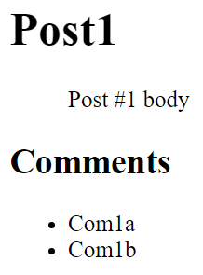
Solution: Blog – Display Post with Its Comments
function displayPostWithComments([post, comments]) {
$("#post-title").text(post.title);
$("#post-body").text(post.body);
$("#post-comments").empty();
for (let comment of comments) {
let commentItem = $("<li>")
.text(comment.text);
$("#post-comments")
.append(commentItem);
}
}
Check your solution here: https://judge.softuni.bg/Contests/360

Slide 34

Async / Await
Simplified Promises

Slide 35
Async / Await Simplify Promises
async function loadData() {
return new Promise(function(resolve, reject) {
setTimeout(function() { resolve('data'); }, 300);
});
}
async function loadMoreData(input) {
return new Promise(function(resolve, reject) {
setTimeout(function() {
resolve(input + ' + more data'); }, 200);
});
}

Slide 36
Async / Await Simplify Promises (2)
async function loadAllData() {
console.log('Before promise');
let data = await loadData();
let moreData = await loadMoreData(data);
console.log('Result: ' + moreData);
console.log('After promise');
}
loadAllData();
console.log('Finished');
Before promise
Finished
Result: data + more data
After promise

Slide 37
Transpiling Async / Await with Babel
npm install -g babel-cli
npm install -g babel-plugin-transform-async-to-generator
.babelrc
{
"plugins": ["transform-async-to-generator"]
}
babel async-await.js -o async-await-transpiled.js

Slide 38

Web Workers
Running Background Tasks in the Browser

Slide 39
Web Workers
<p>Count numbers: <output id="result"></output></p>
<button onclick="startWorker()">Start Worker</button>
<button onclick="stopWorker()">Stop Worker</button>
<button onclick="resetWorker()">Reset Worker</button>
<script>
let worker = undefined;
function startWorker() {
worker = new Worker("counter-web-worker.js");
worker.onmessage = function(event) {
$("#result").text(event.data);
};
}
Run background Web worker
Receive data from the worker

Slide 40
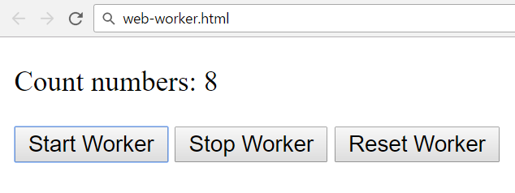
Web Workers (2)
function stopWorker() {
if (worker) {
worker.terminate();
worker = undefined;
}
}
function resetWorker() {
if (worker)
worker.postMessage('reset');
}
</script>

Slide 41
Web Workers (2)
counter-web-worker.js
let count = 0;
setInterval(function() {
postMessage(++count);
}, 500);
onmessage = function(e) {
if (e.data == 'reset')
count = 0;
};
Send data to the main script
Receive data from the main script

Slide 42

Practice: Promises, AJAX, Web Workers
Promises
.then()
.catch()
Live Exercises in Class (Lab)

Slide 43


Summary
Promises hold operations (background tasks)
Can be resolved or rejected
jQuery AJAX works with promises
p.then(function(result) {
/* process the result */ })
.catch(function(error) {
/* handle the error */ });
$.ajax(request)
.then(function(data) { … })
.catch(function(error) { … });

Slide 44









Asynchronous Programming and Promises
https://softuni.bg/courses/javascript-applications

Slide 45
License
This course (slides, examples, demos, videos, homework, etc.) is licensed under the "Creative Commons Attribution-NonCommercial-ShareAlike 4.0 International" license

Slide 46






Free Trainings @ Software University
Software University Foundation – softuni.org
Software University – High-Quality Education, Profession and Job for Software Developers
softuni.bg
Software University @ Facebook
facebook.com/SoftwareUniversity
Software University @ YouTube
youtube.com/SoftwareUniversity
Software University Forums – forum.softuni.bg

